Slide 1

APPICORNS
SPIRITUAL
TECHY BOYS
Team of Hustlers who are trying to add more value to society.
TEAM MEMBERS
Rishabh kumar Singh
Anshul Saini
Kartik Goel
Ankush Singh

Slide 2

APPICORNS
PROBLEM STATEMENT
People in our generation are extremely busy. As a result, they do not take care of their health. Many people spend many hours at the workplace in front of a computer screen or something else, resulting in back discomfort, poor posture, and other issues. Unhealthy lifestyle choices also have an impact on their ability to concentrate. They require good habits that will lead to a healthy and fulfilling life.

Slide 3

APPICORNS
Our Solution
We provide a Yoga and meditation program on our app.
We provide a 15-minute meditation program in which Users may concentrate while listening to relaxing music.
It improves concentration which is helpful in their career. It helps to provide peace to stressed people.
We also have an ebook section where popular spiritual books such as the Bhagwad Geeta, Ramayana, Bible, Quran, etc are summarised.
Providing daily streaks will encourage people to practice yoga. News section which provides details of yoga and meditation campaigns for those who want to learn.

Slide 4




APPICORNS
OUR UNIQUENESS
Providing daily streaks will encourage people to practice yoga and when they complete a milestone, they will be recognized with a badge. With each badge, the person will be rewarded with some free E-books, points, etc.
Our application offer short-duration yoga and meditation programs with deep relaxation to help concentration.
Have a section for news where you may read about yoga
retreats and other events that are related.

Slide 5
APPICORNS
Scalable
Flutter is the main tech stack of this entire project. This gives us the flexibility
RELEVANCE
We have features in our software that can help users focus, relax, and concentrate better, which is beneficial for their careers and also brings peace to anxious people.
Impact
People will have access to a platform where they can meditate while finding time from their busy schedules for themselves.
to use the same the
codebase for and iOS.
web,
android,
Feasibility
As Flutter is the main tech stack, so the cost of development of the project is very less.

Slide 6


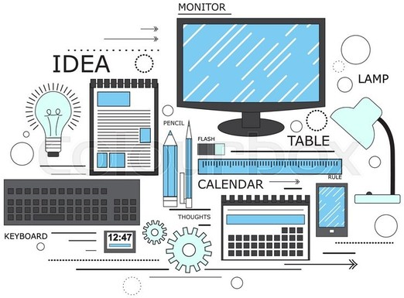
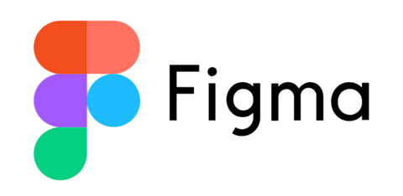
APPICORNS
TECH STACK
Single Code Base for Multiple Channels
For Connecting the Backend
Interactive User Interface

Slide 7
APPICORNS

